Slide 1

Technical Communication Style
Part-II

Slide 2

Eliminate Common Clarity Errors
Three other common issues that affect clarity are
choppy sentences
Wordiness and redundancy
strings of nouns

Slide 3
Avoid Strings of Choppy Sentences
A string of short sentences results in choppiness.
each idea appears as an independent sentence
the effect of such a string is to deemphasize the more important ideas
To avoid this, combine the subordinate ideas so that only the important ones are expressed as main clauses.

Slide 4
Avoid Strings of Choppy Sentences
Choppy
Clear
Both models offer safety belts. Both models have counterbalancing. Each one has a horn. Each one has lights. One offers wing-sided seats. These seats enhance safety.
Both models offer safety belts, counterbalancing, a horn, and lights. Only one offers wing-sided seats, which enhance safety.

Slide 5
Avoid Wordiness and Redundancy
Unnecessary subordinate clause
I found the site by the use of keywords that are nanotechnology and innovation.
Redundant intensifiers plus unnecessary subordinate clause
It is made of very thin glass that is milky white in color.
Redundant: The tuning handle is a metal protrusion that can be easily grasped hold of by the hand to turn the gears.
Unnecessary repetition plus over use of prepositions
This search was done by a keyword search of the same words using the search function of different search engines.
Revised
I found the site using the keywords “nanotechnology” and “innovation.”
It is made of thin, milky white glass.
The tuning handle is a metal protrusion that can be easily grasped to turn the gears.
This investigation used the same keywords in different search engines.

Slide 6
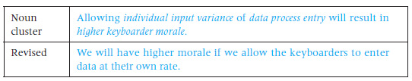
Avoid Noun Clusters
Noun clusters are three or more nouns joined in a phrase. They crop up everywhere in technical writing and usually make reading difficult. Try to break them up

Slide 7
Exercise
Choppiness
Eliminate the choppiness in the following sentences.
XYZ has introduced an LCD monitor. The monitor is 17 inches. The monitor has a Web camera. Web conferencing applications can use the Web camera.
Numerical control exists in two forms. CNC is one form. CNC is Computer Navigated Control. DNC is Distributed Numerical Control.
On-line registration is frustrating. It should make it faster to register. The words on the screen are not self-explanatory. Screen notices say things like “illegal command.” Retracing a path to a screen is difficult.

Slide 8
Technology Demands Conciseness
Resume
E-mail Message
Mobile Messages
Online Help Screens
Microsoft PowerPoint
A one-page resume is standard
It allows for only about 55 lines of text.
Each line allows for only about 70 to 80 characters.
It should be limited to about 20 lines of a text.
It should be according to the screen size.
It is limited by the size of screen.
Fit in your message within the box
Twitter and Instant Messages

Slide 9
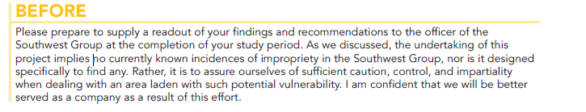
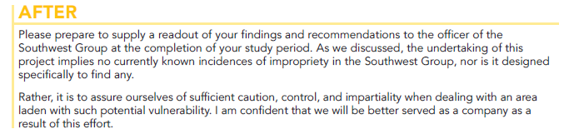
Limit Paragraph Length

Slide 10
Avoid Camouflage Words
A key word is buried in the middle of surrounding words
For example,
The key “except” is camouflaged behind unneeded-with, the-ion, of
Made an amendment of
Make an adjustment of
“With the exception of”
Amend/ change
Adjust
Having a meeting
Meeting
Arriving at an agreement
Agree
At a later moment
later

Slide 11
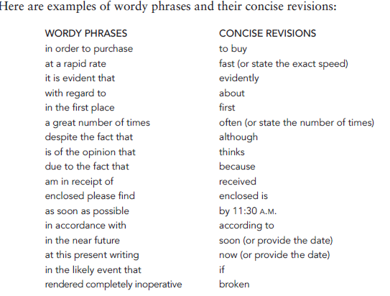
Avoid Wordy Phrases

Slide 12
Limit Paragraph Length
In Tech. Writing a paragraph should consist of no more than four to six typed lines
Or no more than 50 words
You can cut a lengthy paragraph in half
Find a logical place to stop a paragraph
And then start a new one

Slide 13
Write Clear Paragraphs for Your Reader: Put the Topic Sentence First
use the top-down strategy
Put the topic sentence first
follow it by several sentences of explanation.
develop, explain, and support the central idea
topic sentence expresses the paragraph’s central idea

Slide 14
Write Clear Paragraphs for Your Reader: Put the Topic Sentence First
Topic Sentence Supporting details | The second remarkable property of muskeg is that, like a great sponge, it absorbs and accumulates water. Water enters a muskeg forest through precipitation (rain and snow) and through the ground (rivers, streams, seeps). It leaves by evaporation (chiefly of vapor transpired by the plants) and by outflow through or over the ground. However, input and output are not in balance. Water accumulates and is held absorbed in the accumulating peat. One of the commonest plants of muskeg is sphagnum moss, otherwise known as peat moss; alive or dead, its water-holding capacity is renowned, and is what gives peat its great water-retaining power. (Pielou 97)

Slide 15

Any Questions?

